Slide 1

GARBAGE-GUARD
Development of Computer Vision for Creeks Garbage Detection Using Convolutional Neural Network
Celeste · Gunayan · Pepito · Banogbanog · Reyes
Thesis Adviser: Dr. Jonel R. Macalisang

Slide 2

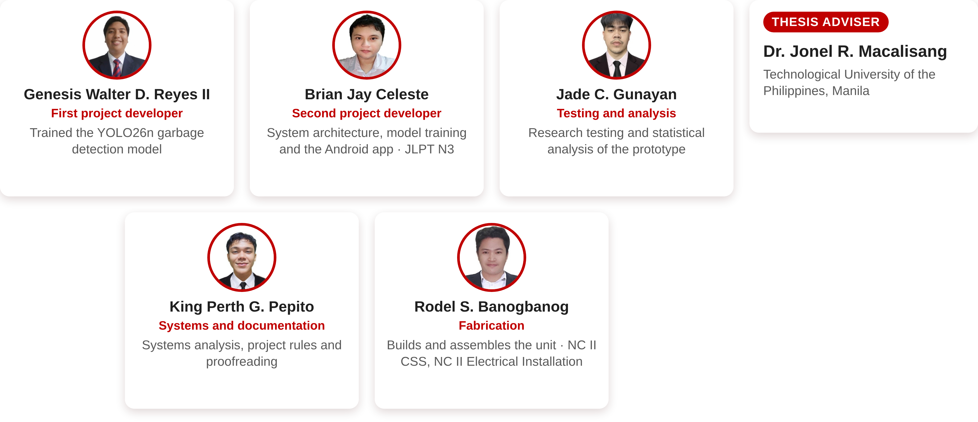

The Researchers
CURRICULUM VITAE

Slide 3
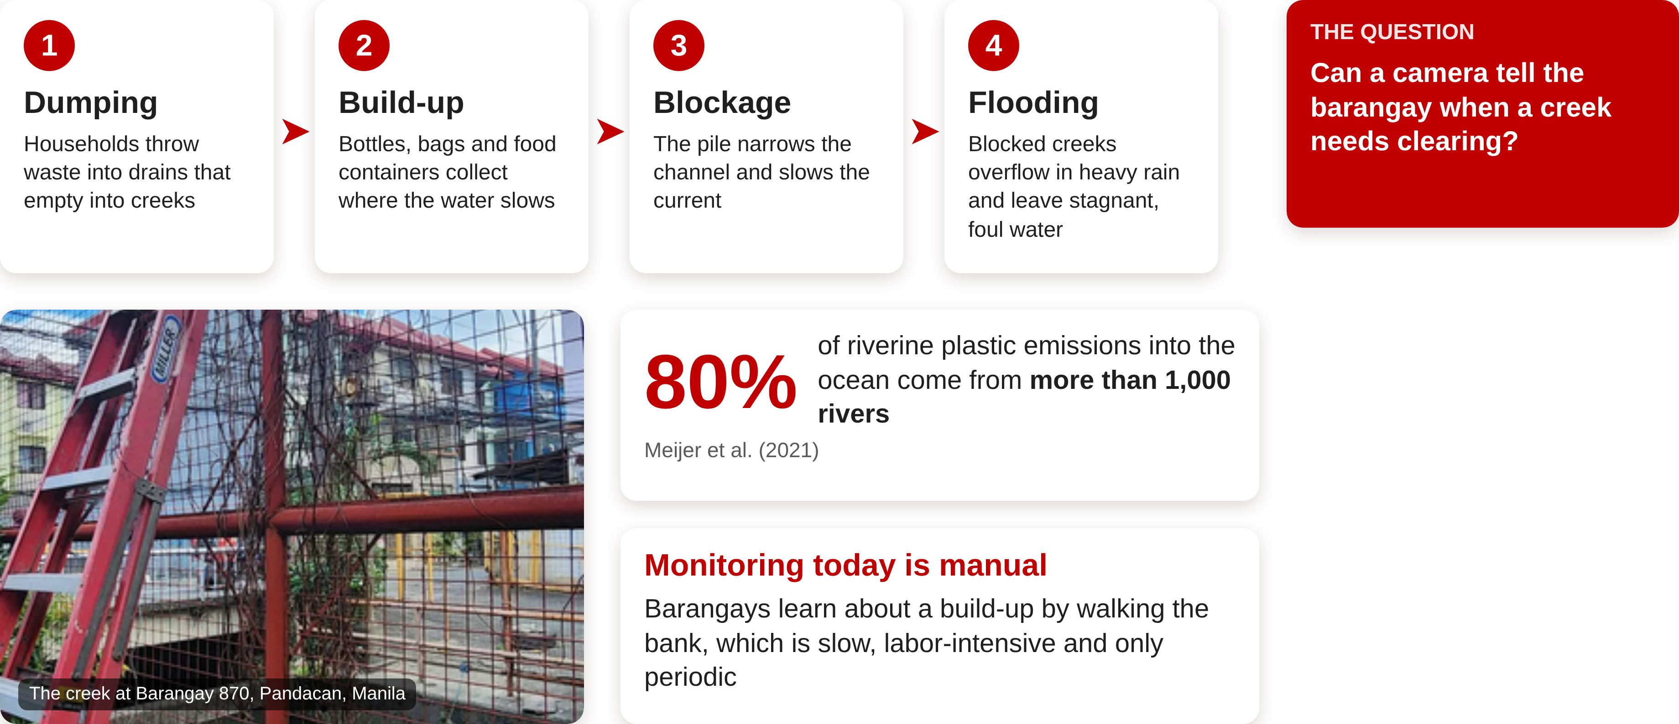
Garbage in Urban Creeks
BACKGROUND OF THE STUDY

Slide 4
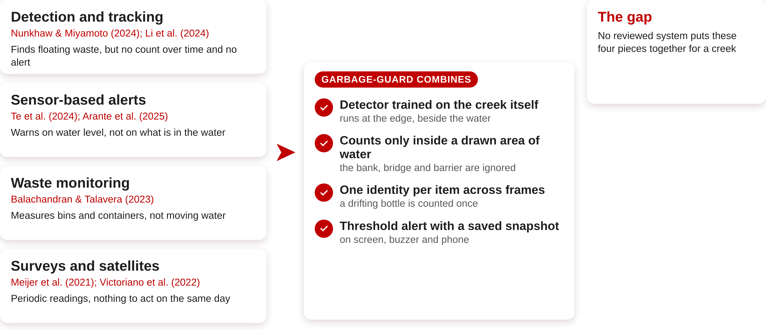
The Research Gap
BACKGROUND OF THE STUDY

Slide 5
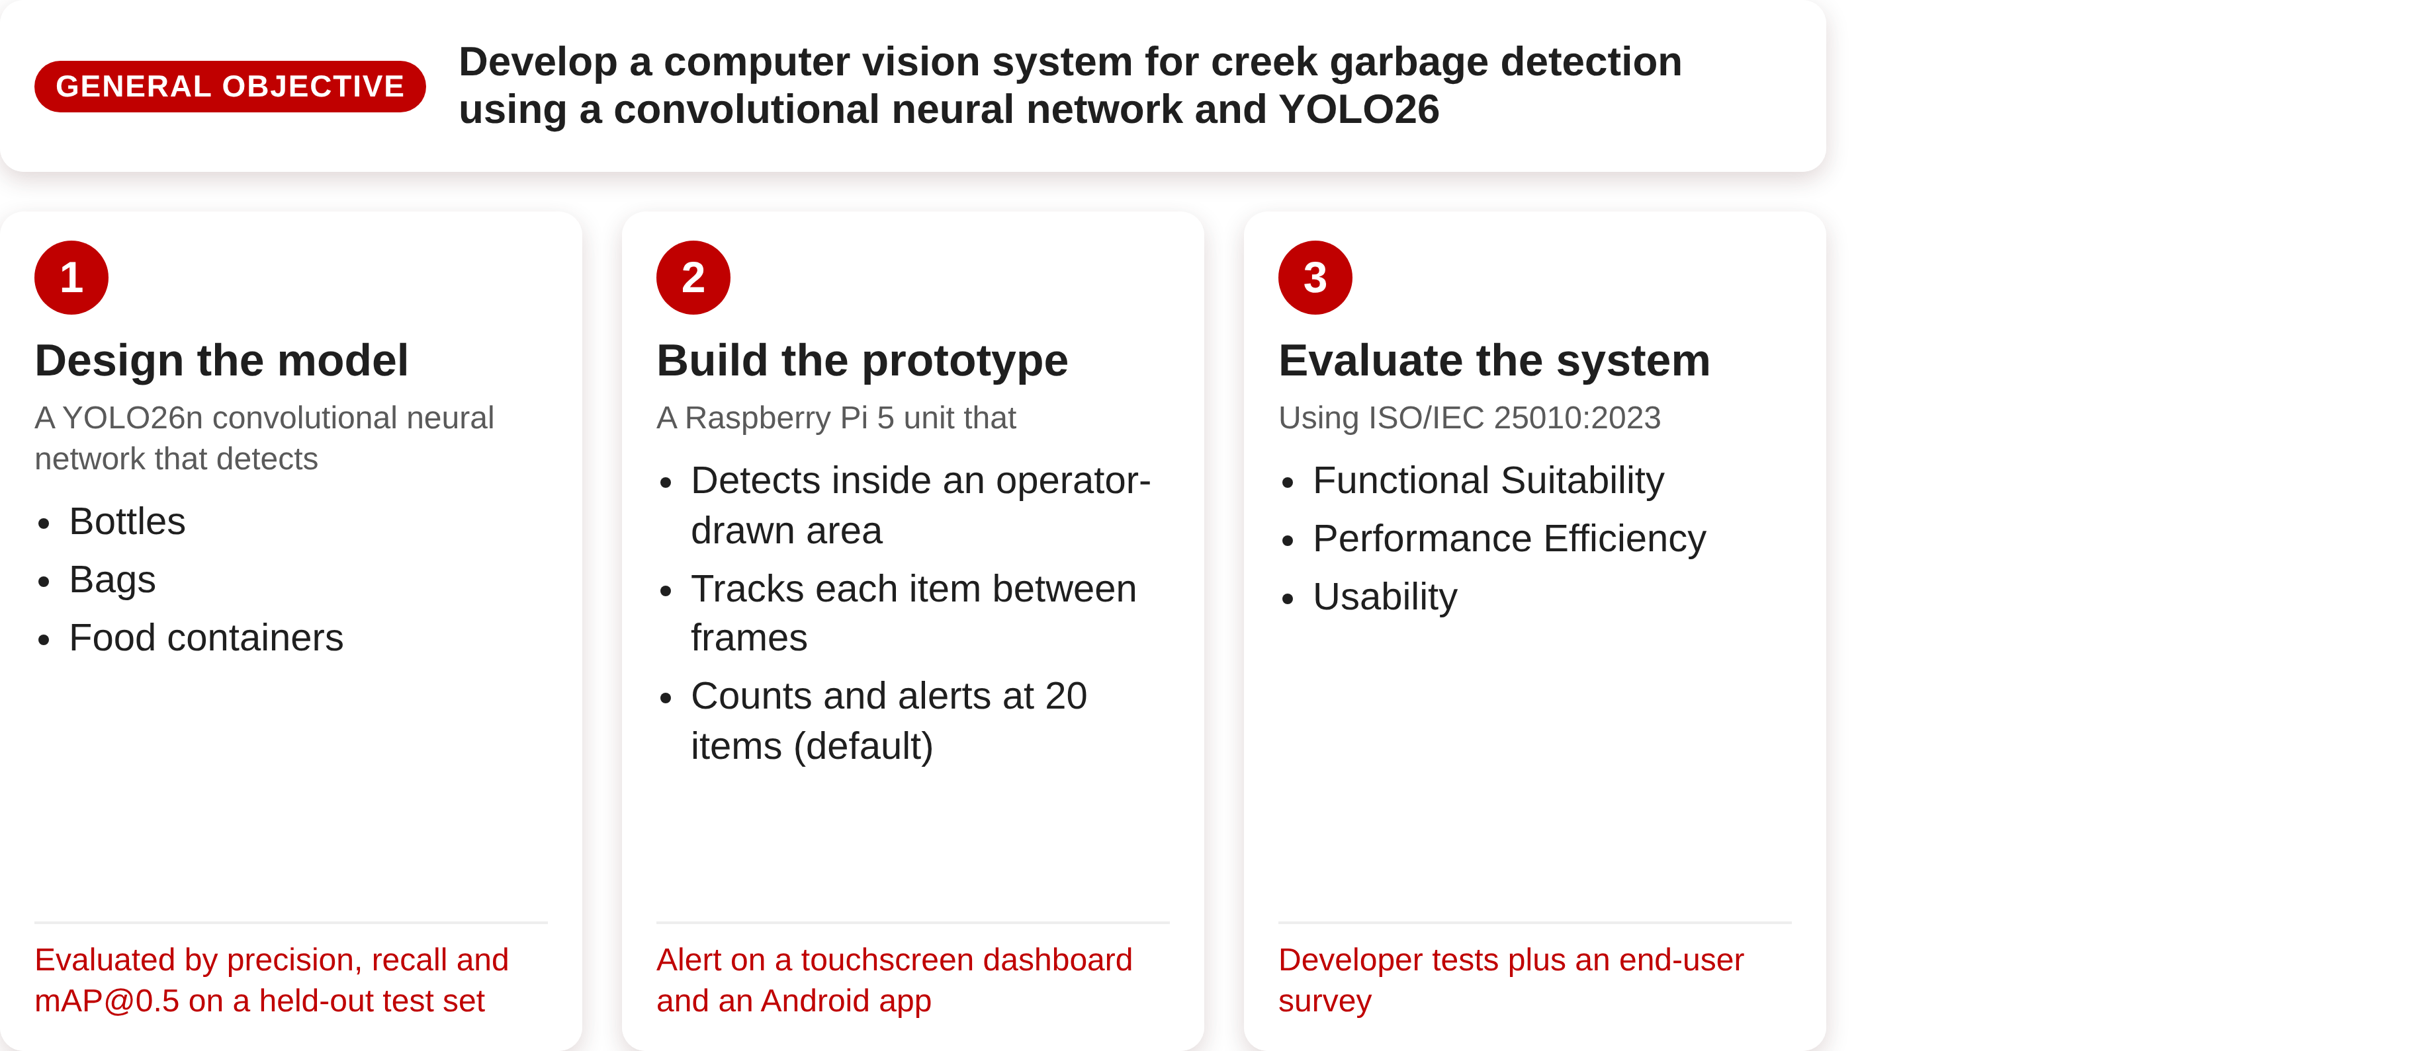
Objectives
OBJECTIVES OF THE STUDY

Slide 6
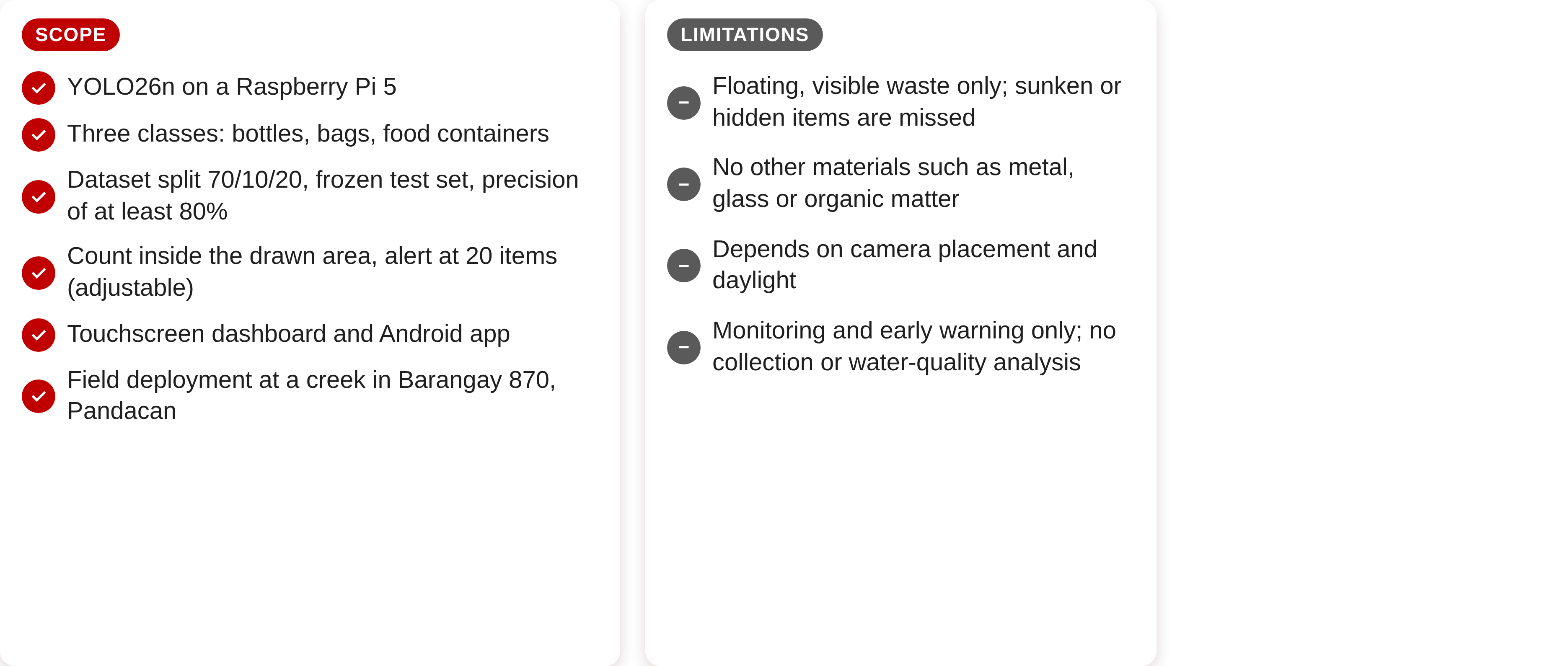
Scope and Limitations
SCOPE AND LIMITATIONS OF THE STUDY

Slide 7
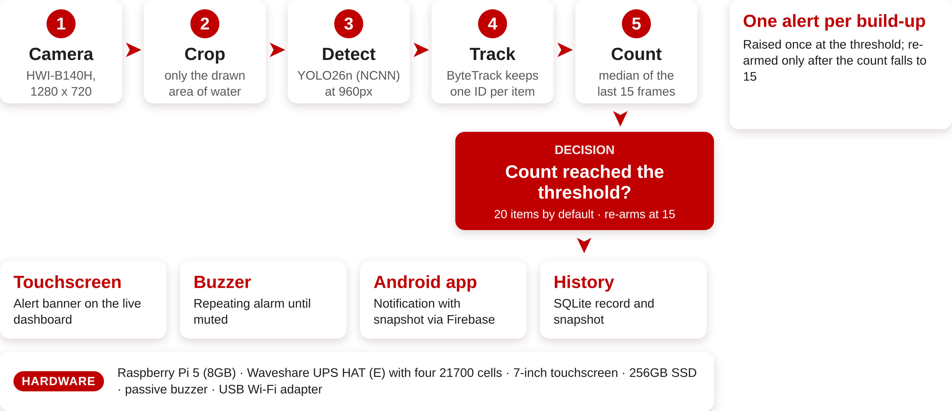
How Garbage-Guard Works
DESIGN

Slide 8
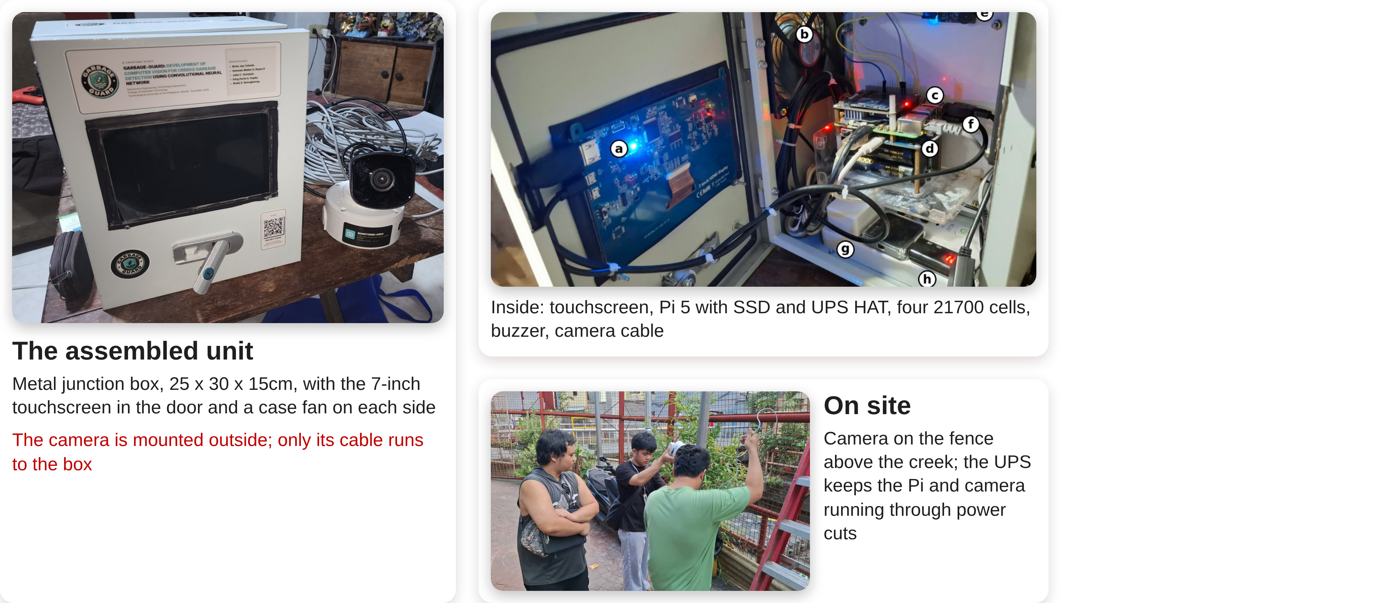
The Prototype
DESIGN/DEVELOPMENT

Slide 9
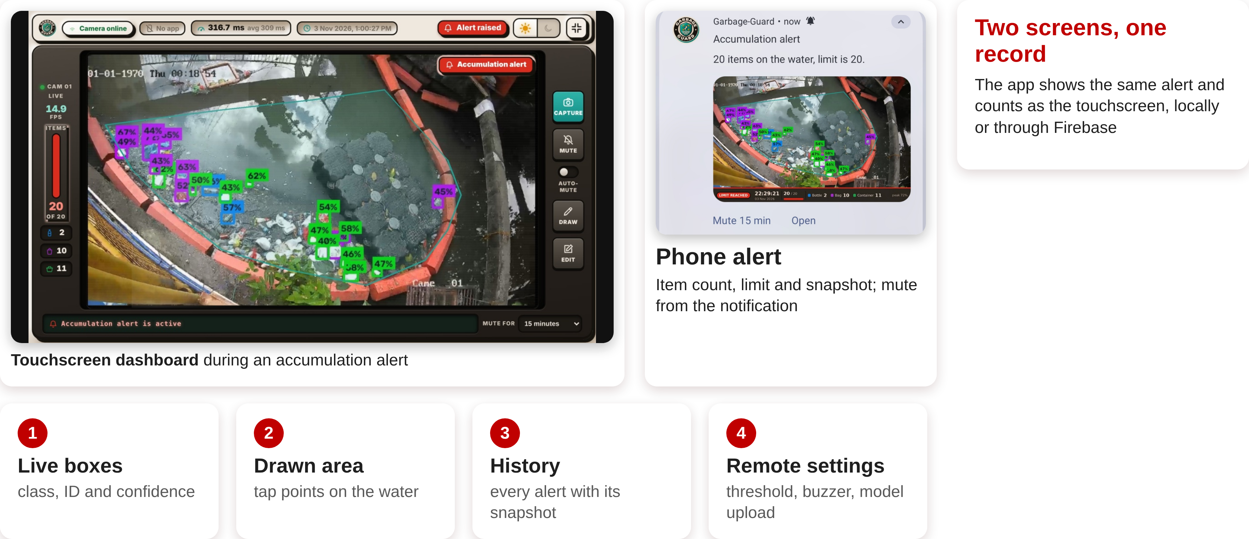
Dashboard and Mobile App
FEATURES

Slide 10
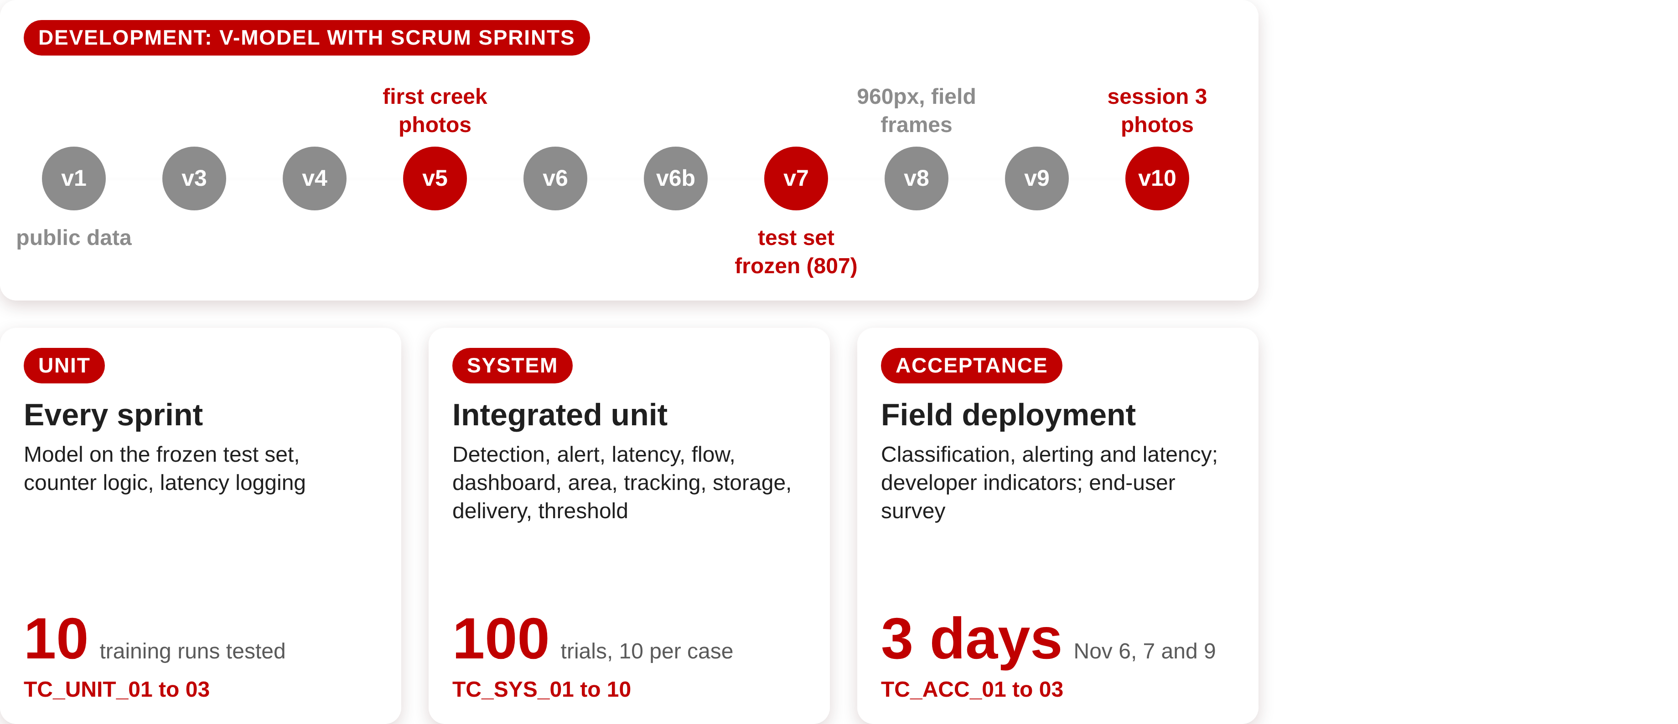
Development and Testing
TESTING PROCEDURE

Slide 11
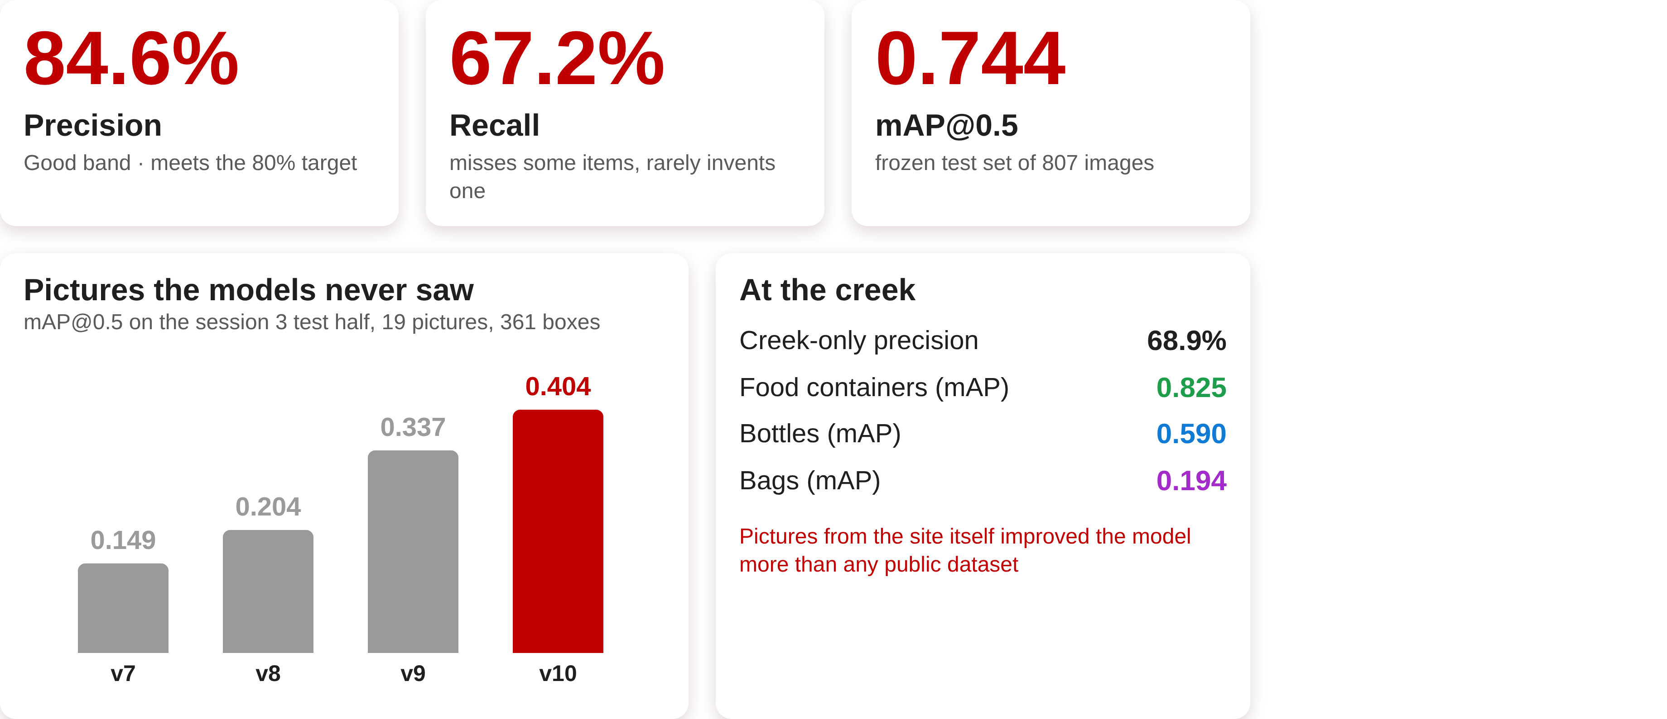
Detection Model Results
TEST RESULTS

Slide 12
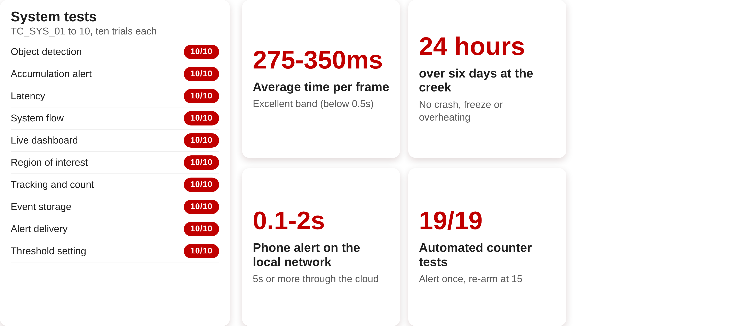
System and Field Results
TEST RESULTS

Slide 13
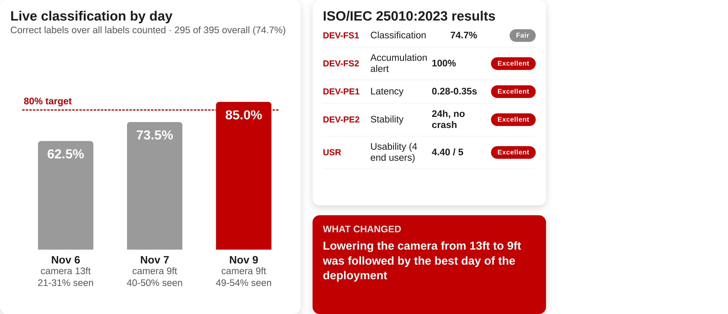
Field Accuracy and Evaluation
TEST RESULTS

Slide 14
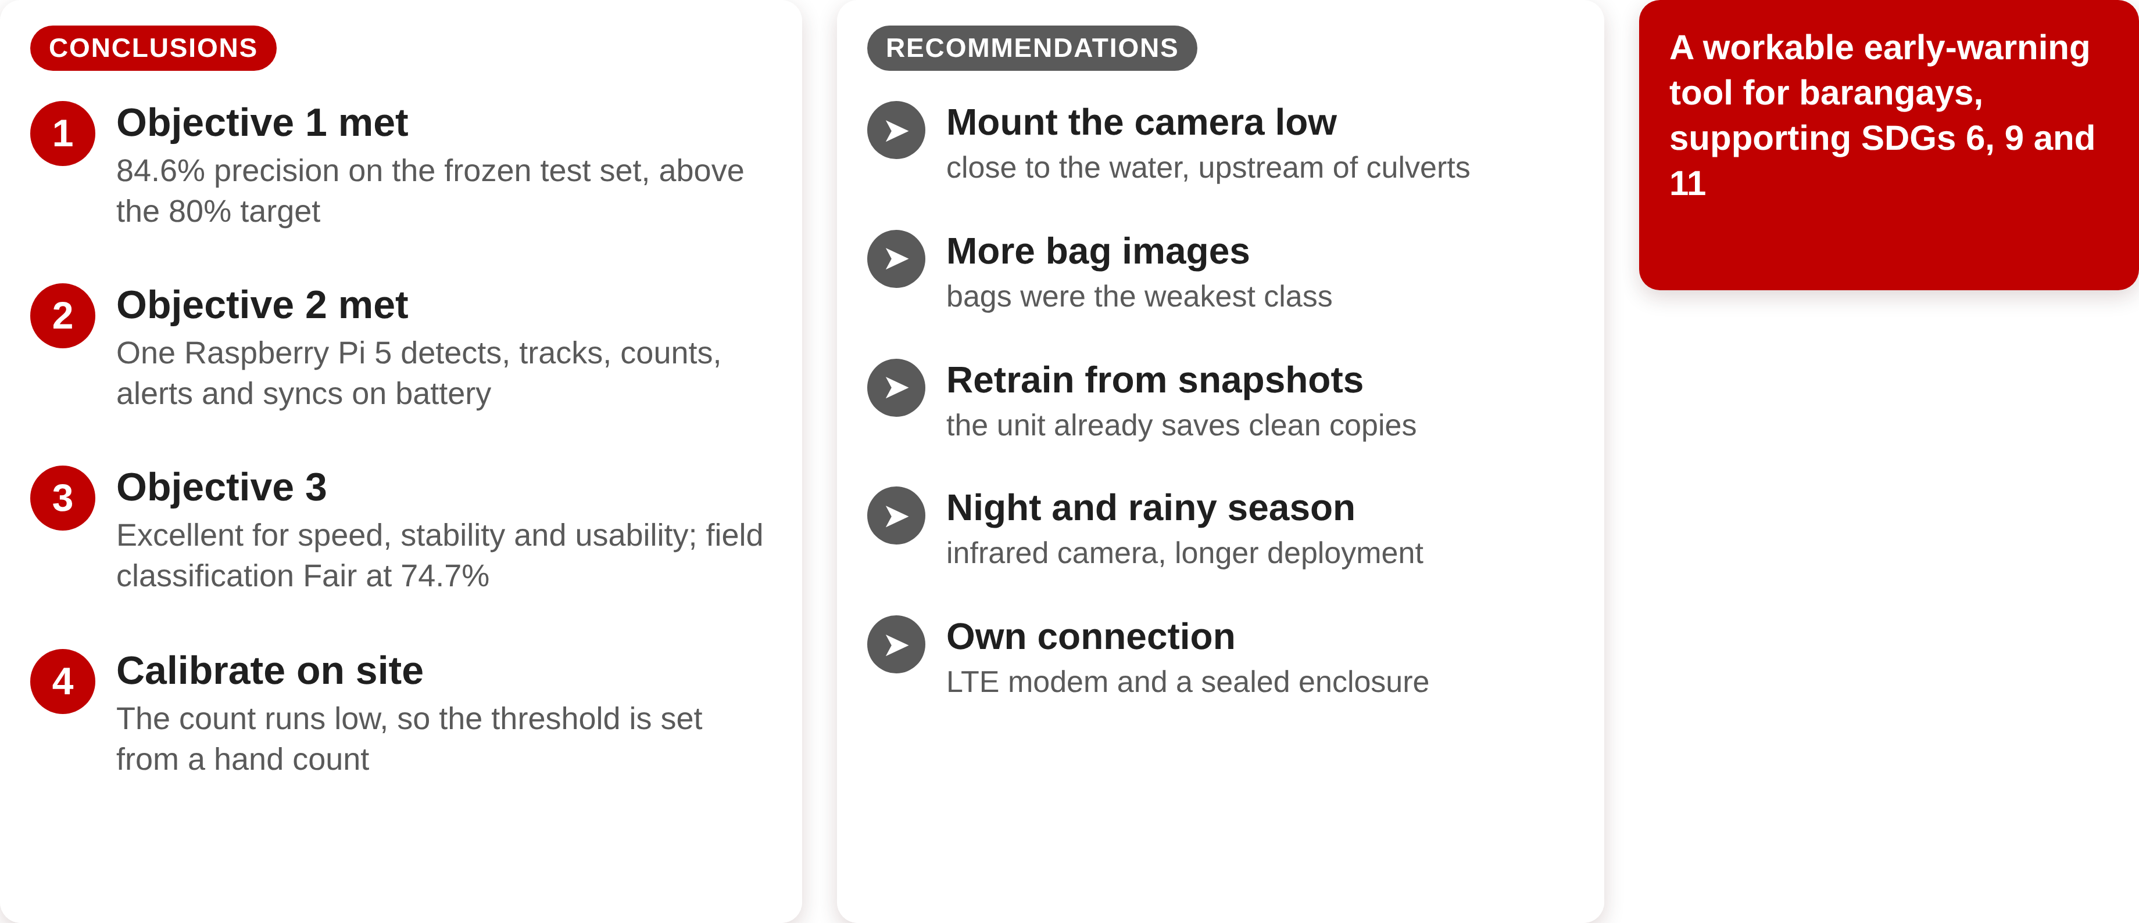
Conclusions and Recommendations
CONCLUSIONS AND RECOMMENDATIONS

Slide 15
THANK YOU!!

